Slide 1
Capstone Project
RETAIL SALES PREDICTION Team Members Jayanth V Gowthaam Kumarasamy

Slide 2
INDEX
Problem Statement
Data Overview
Pre Processing Data
Exploratory Data Analysis
Feature Selection
Machine Learning Model Implementation
Finding the Best Model
Feature Importance
Conclusion

Slide 3
PROBLEM STATEMENT
Rossmann operates over 3,000 drug stores in 7 European countries.
Rossmann store managers are currently tasked with predicting their daily sales up to six weeks in advance.
With thousands of individual managers predicting sales based on their unique circumstances, the accuracy of results can be quite varied.
You are provided with historical sales data for 1,115 Rossmann stores.
The task is to forecast the "Sales" column for the test set. Note that some stores in the dataset were temporarily closed for refurbishment.

Slide 4
DATA OVERVIEW
We are provided with two Data sets
a) Rossman Stores data – Containing the historical data of all stores of each day.
b) Store data – It contains the supplemental information of each store.
Considering this dataset we tend to get some insights on what data these datasets possess as a result we import certain libraries using python and explore the metrics of the data such as
1. Number of rows and columns.
2. Size of the data.
3. Shape of the data.
4. Object type of the data etc.

Slide 5
PRE PROCESSING DATA
While processing the data we tend to :
Handle the missing and null values by replacing them with the mean values and zeros.
Remove some columns if not necessary for our analysis.
Converting the object type into favorable datatypes eg. Str to numeric.
Modifying the columns such as splitting the data in a particular column into three or two separate columns.

Slide 6
EXPLORATORY DATA ANALYSIS

Slide 7
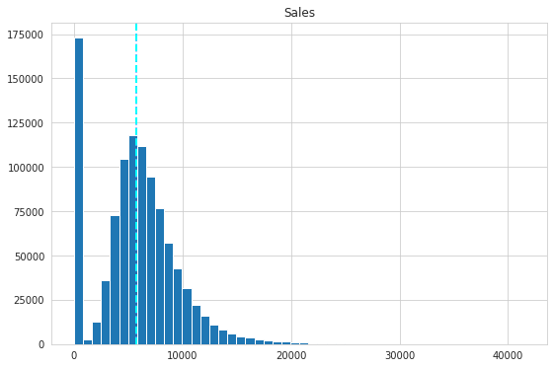
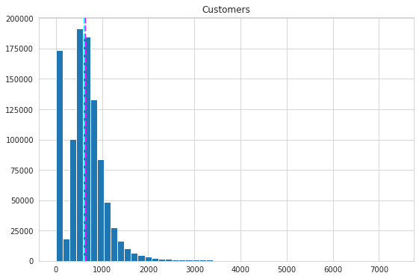
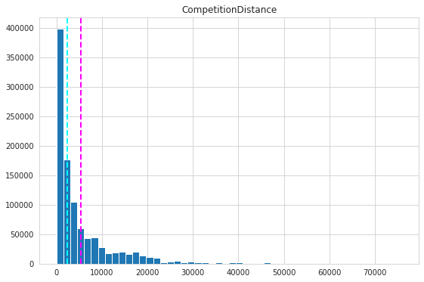
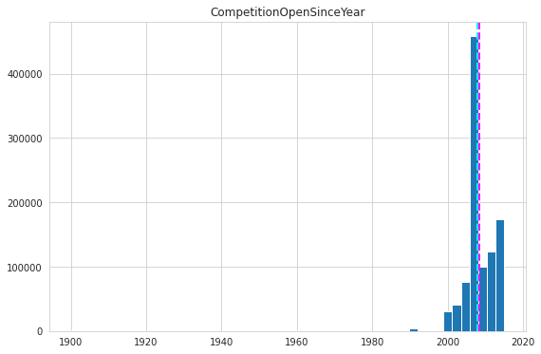
Displaying specific columns in the dataset in the form of a graph that has data that are skewed.
Just to get an idea of the data distribution in specific columns.

Slide 8
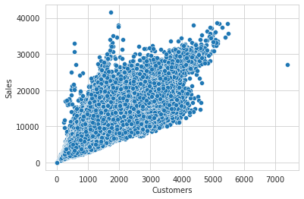
The scatter plot is put up to show the effect that the customers have on the sales.

Slide 9
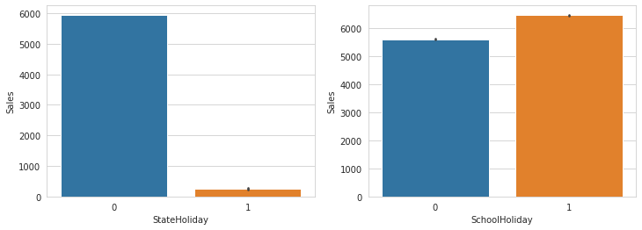
Effect on sales due to State Holidays and School Holidays.

Slide 10
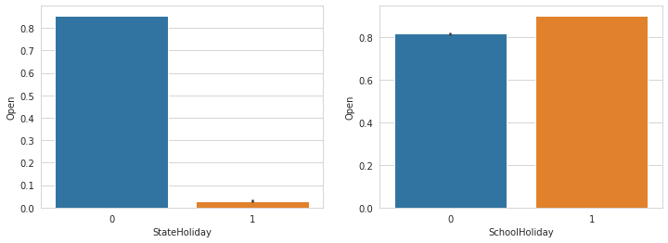
Checking whether stores are open during state and school holidays.

Slide 11
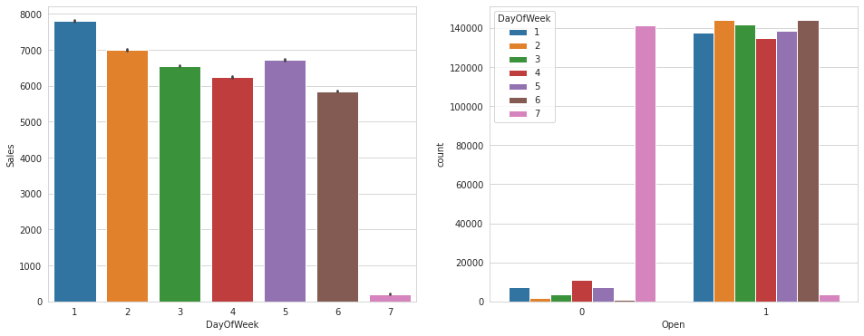
Graph 1 shows the sales that take place on a day of the week and also Graph 2 shows a count plot that tells whether the stores were open on these days. We find out that there is an increase in sales while the stores are open, especially on Mondays.

Slide 12
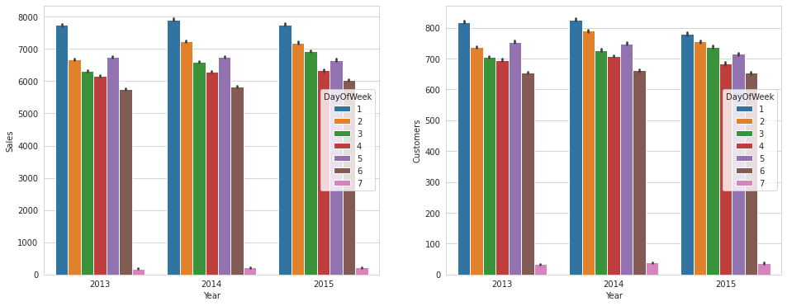
Graph 1 shows that sales take play in different years and also Graph 2 shows the no of customers in these years and we infer that the amount customers were high during the year 2014.

Slide 13
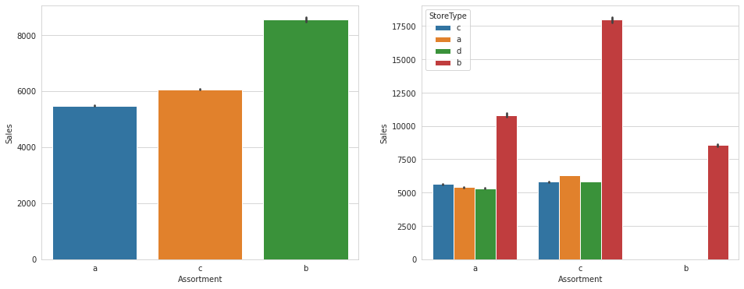
Graph 1 shows the effects that Assortment has on sales and Graph 2 shows the store type involved in determining the sales under varied assortments.

Slide 14
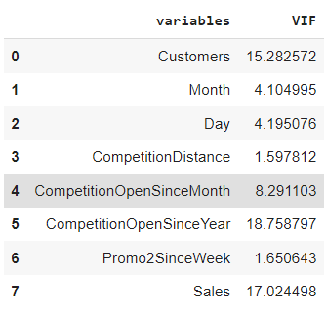
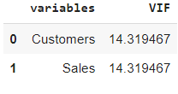
Feature Engineering
Before Removal
After applying VIF, the customer’s column was selected, and the rest were discarded.
One hot encoding was applied on categorical columns like Store type, assortment, and Promo Interval.
Removing CompetitionDistance,CompetitionOpenSinceMonth, CompetitionOpenSinceYear since it has very low correlation with independent variable sales (<0.03)
After Removal

Slide 15
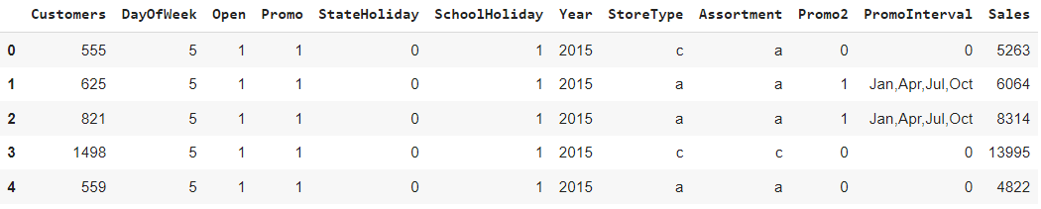
The final columns that we Consider after performing feature selection

Slide 16
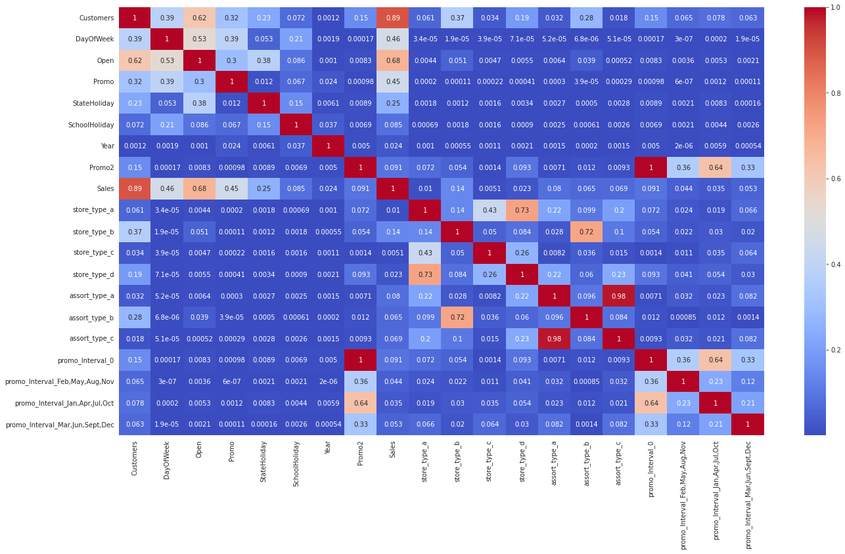
After performing one hot encoding the columns are displayed in the form of a heat map.

Slide 17
Machine Learning Model Implementation

Slide 18
Linear Regression
Linear regression is used as our first model to predict the sales from the data.
The parameters that we have found are listed below.
Other parameters:
Mean Squared Error: 1502490.7985908391
Root of Mean Squared Error : 1225.7613138742954
r2 score test: 0.8983205251368941

Slide 19
Lasso Regularization
Lasso regularization is applied in order to determine the accuracy of the prediction compared to linear regression.
We find that there is a slight difference in the accuracy compared to the previous model
Final Parameters :
MSE score for lasso : 1502499.995706478
RMSE score for lasso: 1225.765065461762
R2 score for lasso: 0.8983199027318256

Slide 20
Decision Tree
Decision Tree shows a good improvement in prediction accuracy.
After applying, accuracy was increased from 89 to 92.22, and RMSE was decreased from 1225 to 1072.
Final Parameters :
Testing RMSE: 1072.613743887029
R2 score: 0.922141113472154

Slide 21
RANDOM FOREST
Random Forest implementation got us an accuracy around 91 which is less compared to decision tree in which it shows around 92 and also other metrics are displayed below for comparison.
Random Forest Metrics : Decision Tree Metrics :
RMSE: 1151.2184971819192
R2 score: 0.9103114523209124
Testing RMSE: 1072.613743887029
R2 score: 0.922141113472154

Slide 22
Hyper Paramater Tuning
After applying all the Machine learning models we got high accuracy for the Decision tree hence we tend to perform hyper parameter tuning only for this model.
We applied the decision tree again after hyperparameter tuning where we found the optimal value for parameter min_samples_leaf as 30.
After putting that value in the decision tree model its accuracy is increased from 92.22 to 92.46, and the rmse value is decreased to 1055 from 1072.

Slide 23
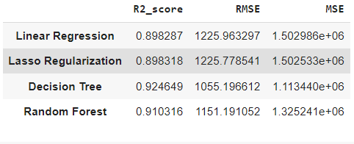
Final Evaluation
As we have arrived at a conclusion that the decision tree model is performing well with our dataset in terms of prediction, In order to show the comparison between various models and their metrics we tend to form a data frame in which we rope in all the metrics found and displayed them.

Slide 24
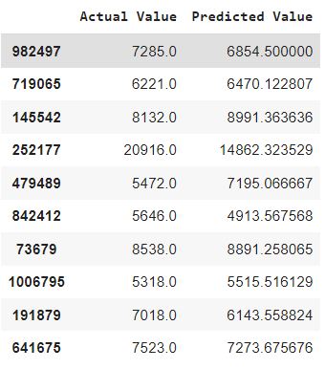
The dataframe shows the comparison of the actual value and the predicted value after applying our models.

Slide 25
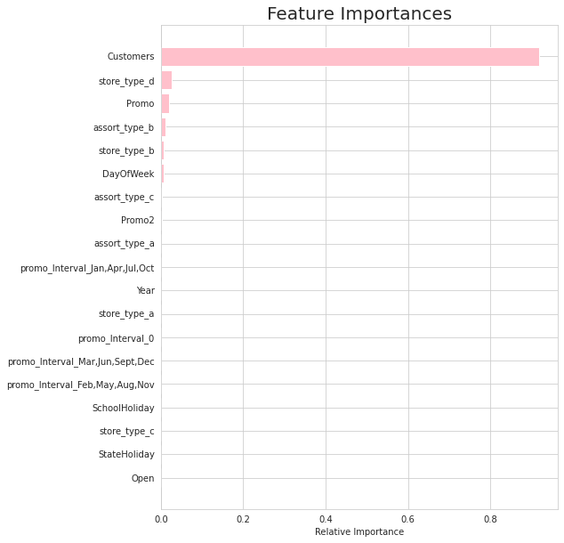
Feature Importance
After applying the Decision Tree model the customers is the feature that has a high impact on predicting the sales compared to other features in the dataset
The graph is shown for reference.

Slide 26
CONCLUSION
The main objective of sales forecasting is to paint an accurate picture of expected sales. Sales teams aim to either hit their expected target or exceed it.
When the sales forecast is accurate, operations go smoothly and future planning for the company's growth is done efficiently.
Upon having this analysis, it can be established that given the dataset, the model developed is able to explain 92.4649% of the variations and is able to predict the sales values in a good range.

